Slide 1
MODULE 3 ARRAY PROCESSORS
SIMD ARRAY PROCESSORS

Slide 2
SIMD Array Processor
Synchronous array of parallel processing elements
Array processor consists of multiple processing elements (PE), under supervision of one Control Unit (CU)
SIMD machines are designed to perform vector computations over matrices or array of data.
SIMD computers appear in 2 basic architectural configurations :- Array Processor (using RAM)
:- Associative Processor (using content-addressable memory

Slide 3
SIMD COMPUTER ORGANISATION
2 different configuration- Illiac & BSP
Illiac : N synchronized PE’s under the control of one CU
Each PEi is essentially an ALU with attached registers & local memory PEMi
CU has its own memory for storage of programs
Function of CU : decode all instructions & determine whether decoded instructions should be executed.
Scalar instructions are directly executed in CU

Slide 4
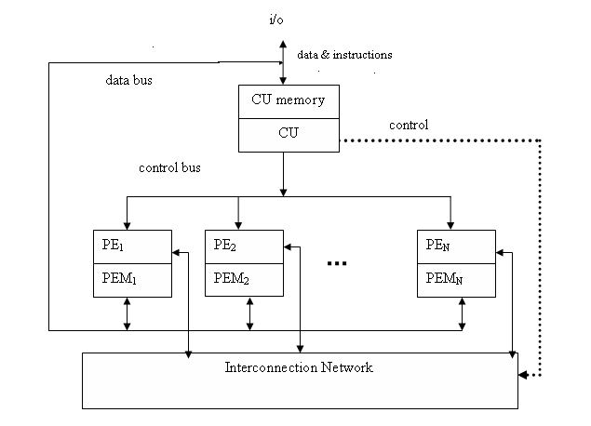
Configuration I (ILLIAC IV)

Slide 5
Vector instructions broadcast to PE’s to achieve parallelism
Vector instructions are distributed to PEM’s before parallel execution in PE’s.
Distributed data can be loaded into PEM’s from an ->external source via System data bus
-> CU via Control bus
Masking vector is used to control the status of all PE’s
PE may be either active or disabled during an instruction cycle. ie all PE’s need not participate in the execution of vector instruction, only enabled PE’s perform computation.

Slide 6
Data exchanges among PE’s are done by inter-PE communication network(which is under control of CU)
An Array Processor is interfaced to a host computer through the CU
Fns of Host computer :
resource management
peripheral & I/O supervisions
I/O functions with outside world
Fns of CU :
Supervises the execution of programs within the system

Slide 7
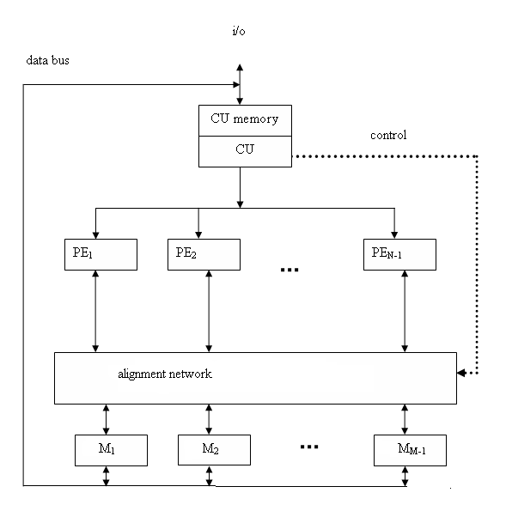
Configuration –II (BSP)

Slide 8
Configuration II (BSP)
Configuration II differs from I in 2 aspects
Local memories attached to PE’s are replaced by parallel memory modules shared by all PE’s via an allignment network
Inter-PE connection network is replaced by
inter-PE-memory allignment network
Allignment n/w is a path-swithching n/w between PE’s and parallel memories
Allignment n/w allows conflict-free accesses of shared memories by as many PE’s as possible.

Slide 9
Formally a SIMD computer is characterized by following set of parameters.
C=<N,F,I,M>
N=Number of PEs in the system.
F=A set of data routing functions.
I=Set of machine instructions
M=Set of masking schemes.
(each mask partitions set of PE’s into enabled & disabled)

Slide 10
Masking and data routing mechanisms
Masking schemes are used to control the status of each PE.
Each processor(PEi with its own memory, includes a set of
working registries, Ai, Bi, Ci
flags Si,
Arithmetic logic unit
local index register Ii
address register Di,
data routing register Ri.
The Ri of each PEi is connected to the Rj of other PEs via the interconnection network

Slide 11
Components in a PE

Slide 12
When data transfer among PE’s occurs, it is the contents of the Ri registers that are being transferred.
We shall denote the N PEs as PEi for i=0,1,2,…N-1, where the index i is the address of PEi.
The address register Di is used to hold the m-bit address of the PEi.

Slide 13
When data transfer occurs among PE’s , contents of R register are transferred
If a PE_{i} is active, it executes the instruction broadcast to it by CU.
If a PE_{i} is inactive, it will not execute the instruction broadcast to it.
Masking schemes are used to specify the status flag S_{i} of PE_{i}
S_{i} = 1 for an active PE_{i} & S_{i} = 0 for an inactive PE_{i}

Slide 14
Inter-PE Communications
Fundamental decisions in determining appropriate architecture of an interconnection n/w for SIMD m/c
N/w design issues are made b/w
Operation modes
Control strategy
Switching methodology
Network Topology

Slide 15
Operation mode
Operation mode
Synchronous, Asynchronous, Combined
Synchronous -> establishing communication paths synchronously
Asynchronous-> multiprocessing, connection requests are sent dynamically
A system may be designed to facilitate both (Combined)
All existing SIMD machines choose Synchronous mode

Slide 16
Control Strategy
Interconnection functions are realized by properly setting control of the switching elements.
The control setting function can be managed by a centralized controller(centralized control) or by the individual switching elements(distributed control)
Most existing SIMD interconnection n/w’s choose centralized control ( by CU)

Slide 17
Switching Methodology
Packet switching & Circuit switching
Circuit switching -> a physical path established b/w source & destination
Packet switching -> data is put in a packet & routed through the n/w without establishing a physical path
Integrated switching -> capabilities of both switching
SIMD interconnection networks assume circuit switching

Slide 18
Network Topology
Static & Dynamic
Static topology
links b/w 2 processors are passive
Cannot be reconfigured for direct connections b/w other processors
Dynamic topology
links are active, thus can be reconfigured.

